Slide 1


Adaptive AI Framework for 3D Cell Detection, Tracking & Lineage Reconstruction
An advanced computational pipeline for time-lapse microscopy analysis, real-time 3D spatial mapping, and automatic mitosis family tree reconstruction.
DEVELOPER
DEVELOPER
DEVELOPER
DEVELOPER
Khan Amaan Adil
Yedge Narendra Kasturi
Yedge Sarang Laxman
Yedge Jayesh Suresh
221854
231863
221810
231863

Slide 2

Part 1: Biological Foundations
Understanding cellular mechanics, motility, growth dynamics, and lineage trees in virtual microscopic environments.

Slide 3








Cellular Dynamics & Mitosis
Cell Motility
Growth & Size
Mitosis & Lineage
Simulating micro-space movement characterized by physical vibrations and stochastic shifts, accurately mirroring Brownian Motion observed in real biological specimens.
Cells absorb virtual nutrients dynamically over time, progressively expanding their radius prior to reaching their division maturity threshold.
When cells cross age limits, mother cells divide into two daughter cells, recursively constructing complex biological family lineage trees.

Slide 4
Part 2: Algorithmic Pipeline
Step-by-step backend architecture powering detection, spatial matching, mitosis reconstitution, and database persistence.

Slide 5






End-to-End Processing Pipeline
Input / Simulator
3D Detections
Distance Matching
Mitosis Logic
JSON DB Save
Raw TIFF upload or synthetic 3D cell generation.
Centroids extracted with radius & confidence scores.
Euclidean nearest-neighbor association across frames.
Detecting 1-to-2 splits & linking child tracks.
Validated via Pydantic schemas into structured storage.

Slide 6
Spatial Nearest-Neighbor Tracking
Frame Shuffling: The simulator shuffles cell orders and strips tracking IDs to simulate unorganized raw computer vision detections.
Euclidean Distance Formula:
Continuous Linking: The tracker connects temporal points to maintain persistent track identifiers across multi-frame sequences.
Distance = √((xt - xt-1)2 + (yt - yt-1)2 + (zt - zt-1)2)
Distance Thresholds: Matches points within tight spatial boundaries (e.g., 12µm) to preserve physical tracking continuity.
Used to evaluate proximity between frame t and frame t-1 coordinates for identity assignment.

Slide 7

Mitosis & Division Reconstitution
1-to-2 Split Detection: When a single mother cell from frame t-1 becomes the nearest neighbor to two distinct cells in frame t, mitosis is flagged.
Database Persistence
Track Termination: The mother cell track safely terminates at frame t-1.
All tracking results, metadata, spatial coordinates, and lineage graph connections are thoroughly validated using Pydantic data models before being committed to optimized JSON storage.
Child Generation: Two new distinct tracks are instantiated at frame t.
Parent-Child Mapping: Establishes direct lineage edges and updates track hierarchies.

Slide 8
Part 3: 3D Visualization & Lineage Trees
Interactive WebGL rendering and custom SVG hierarchy charts built for real-time biological data exploration.

Slide 9
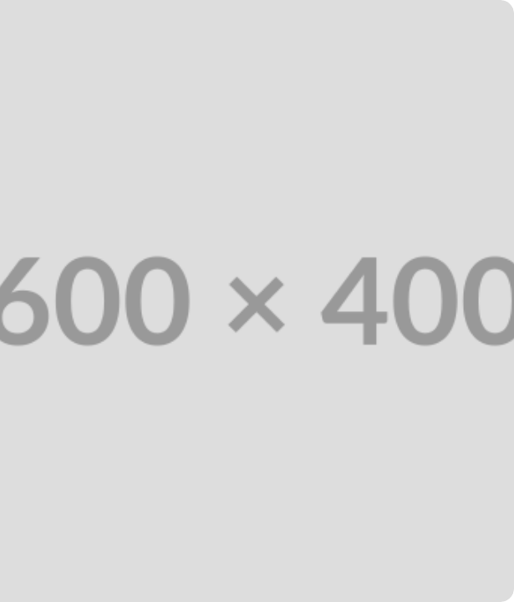
3D Space Viewport (Three.js)
WebGL Rendering: Three.js creates a virtual 3D environment complete with custom lighting and OrbitControls.
Sphere Meshes: Each cell is rendered as a 3D sphere at coordinates (x, y, z) with scale proportional to its radius.
Historical Trails: Past cell pathways are rendered using dynamic buffer geometry.

Slide 10
Lineage Tree Hierarchy (SVG)
Custom SVG Architecture: Built from scratch using native SVG paths without heavy external charting bloat.
Time Axis (Y-Axis): Vertical progression represents time frames from top to bottom.
Division Bridges: Dotted horizontal bridges connect mother lines to split child tracks.

Slide 11
System Architecture Summary
Module | Core Technology | Key Responsibility
Simulation & Detection | Python, NumPy, StarDist/Cellpose concept | Generates 3D cell coordinates, radius, and noise/shuffling.
Tracking Engine | Spatial Euclidean Matching | Links cells across frames and detects mitosis splits.
3D Viewport | React, Three.js, WebGL | Renders spheres, motion trails, and interactive raycasting.
Lineage Trees | Custom SVG Hierarchy | Visualizes family trees and mitosis division bridges.

Slide 12
"Empowering biological discovery through intelligent 3D tracking and computational visualization."
Thank You! Questions are welcome.
AI Bio Lab • Adaptive 3D Cell Tracking System

